Slide 1
Machine Learning – Webinar 1

Slide 2
Case Study – Loan approval data

Slide 3
Overview
The Problem
This case study will help us to understand the stages in the data science project lifecycle with loans data set to predict whether the loan will be approved or not. We will focus on the following eight stages namely -
Business Understanding
Data Acquisition
Data Preparation
Exploratory Data Analysis
Data cleaning
Feature Engineering
Model Building and
Model Selection
3

Slide 4
1. Business Understanding
Background of the problem
Home Loans are tailor made for salaried individuals as well as the other individuals as they offer an attractive rate of interest and a longer tenure.
Banks are having dedicated workforces deployed into the field catering to the different regions like urban, semi-urban and rural areas who reach out to customers through different channels.
The customers are asked to submit an application for the home loan in which many interesting characteristics of customers are captured.
The loan approval team decides whether to consider the application for the disbursement or not based on this data.
What are the factors/characteristics of customers that influence loan approval by a bank??????

Slide 5
1. Business Understanding
Different factors can affect the loan approval.
Few of the immediate ones can be listed as follows -
INCOME OF APPLICANT
IS APPLICANT SELF EMPLOYED OR SALARIED
AGE OF APPLICANT
JOB TYPE OF APPLICANT
MARITAL STATUS
CREDIT HISTORY FOR PREVIOUS LOANS (CIBIL SCORE)
LOAN AMOUNT
TENURE OF THE LOAN ETC.

Slide 6
2. Data Acquisition – Data sources
Categories of customers
As the customer categories are different like Urban, Semi-urban and rural, the dataset is provided into three different CSV files.
What to do with the three types of data sets?
We need to acquire these datasets and prepare a data frame which can be used for further data exploration and model building.
Let us start analyzing the data using Python
Python has several packages for data analysis which needs to be installed.
Once the required packages are installed we can import the required components from these packages

Slide 7
Packages – Listing and installation
Listing all the packages installed in your system
Follow the steps below to list all the packages installed on your system:
Step 1: Open the command prompt (cmd) of your system.
Step 2: Type in the command pip list on the cmd terminal.
C:\Windows\system32>pip list
From Anaconda prompt
(base) PS C:\Users\Username> pip list
Installing required packages
Cmd prompt> pip install package name

Slide 8
Packages used in this case study
Pandas: It is an open-source, BSD-licensed library. (Berkeley Source Distribution)
Pandas enable the provision of easy data structure and quicker data analysis for Python.
For operations like data analysis and modelling, Pandas makes it possible to carry these out without needing to switch to more domain-specific language like R.
NumPy : It is one of the fundamental packages for Python, providing support for large multi-dimensional arrays and matrices along with a collection of high-level mathematical functions to execute these functions swiftly.
NumPy can also be used as an efficient multi-dimensional container of generic data.
Seaborn : When it comes to the visualization of statistical models like heat maps, Seaborn is among the reliable sources.
This Python library is derived from Matplotlib and is closely integrated with Pandas data structures.
Matplotlib : It is a comprehensive library for creating static, animated, and interactive visualizations in Python.

Slide 9
2.1 Package Imports
#Need to import the required packages
import pandas as pd
import numpy as np
import seaborn as sns
import matplotlib.pyplot as plt # pyplot is an API for matplotlib.
%matplotlib inline # tells the IPython environment to draw the plots immediately after the current cell.
import warnings # This is the base class of all warning category classes. It is a subclass of Exception.

Slide 10
2.2 Reading data from Loans Datasets
urban_data=pd.read_csv("Urban_loans.csv") //read data from csv file and load into urban_data
urban_data.head(2) # returns the first n (2 rows here) rows for the object
semiurban_data=pd.read_csv("Semi_Urban_loans.csv")
semiurban_data.head(2)
rural_data=pd.read_csv("Rural_loans.csv")
rural_data.head(2)

Slide 11
2.3 Confirm the imports
urban_data.shape # shape - used to find the dimensions of data structures, such as NumPy arrays and Pandas DataFrames. (rows,columns here)
semiurban_data.shape
rural_data.shape

Slide 12
2.4 Quick Look at columns
As the data is coming from three different sources, lets quickly look at the structure of the data frames and the actual data values present in the columns in order to identify the similarities and dissimilarities between them.
urban_data.columns # returns column labels of a data frame
Index(['Loan_ID', 'Gender', 'Married', 'Self_Employed', 'Education', 'Applicant_Income', 'Dependents', 'Loan_Amt', 'Tenure', 'CoapplicantIncome', 'Credit_History', 'Approved'],
dtype='object')
semiurban_data.columns - Index(['LID', 'Gender', 'Applicant_Income', 'Dependents', 'Education’, 'Marrital_Status', 'Self_Employed', 'LoanAmt', 'LoanAmountTerm', 'Coapplicant_Income', 'Credit_History', 'Approved'], dtype='object')
rural_data.columns - Index(['Loan_ID', 'Sex', 'Marrital_Status', 'DependentsCount', 'Self_Employed',
'Education', 'Loan_Term', 'LoanAmount', 'Income', 'Loan_Status'],
dtype='object')
Though the columns looks similar but still the naming of these columns is different.
We need to do a careful analysis of each and every column of these three dataframes.

Slide 13
3. Data Preparation
As we have seen the data is coming from three different data sources, a lot data preprocessing needs to be done to standardize the columns and the data values present in it.
Lets try them out one by one.
#Merging the columns from all the three data sets.
columns = set(urban_data.columns.append(semiurban_data.columns).append(rural_data.columns))
columns # list of columns

Slide 14
3. Data Preparation
After merging the columns the list of columns are as follows:
{'Applicant_Income',
'Approved',
'CoapplicantIncome',
'Coapplicant_Income',
'Credit_History',
'Dependents',
'DependentsCount',
'Education',
'Gender',
'Income’,
'LID',
'LoanAmount',
'LoanAmountTerm',
'LoanAmt',
'Loan_Amt',
'Loan_ID',
'Loan_Status',
'Loan_Term',
'Married',
'Marrital_Status',
'Self_Employed',
'Sex',
'Tenure'}

Slide 15
3. Data Preparation
There seems to be lot of attributes present in these datasets which are having same meanings but are named differently.
Loan_ID, LID seems to be same
CoapplicantIncome, Coapplicant_Income seems to be same
Dependents, DependentsCount are same
LoanAmount, LoanAmt, Loan_Amt are same
LoanAmountTerm, Loan_Term and Tenure are same
Married, Marrital_Status are same
Gender, Sex are same
Income, Applicant_Income are same
Approved, Loan_Status are same and seems to be target variable

Slide 16
3. Data Preparation
We can think of the following columns for the merged datasets.
Loan_ID
Gender
Married
Tenure
Education
Self_Employed
Income
CoapplicantIncome
Credit_History
Dependents
Loan_Amt
Approved ( Target)
After looking at the columns, its now time go ahead and have look at the unique values of similar columns.

Slide 17
3.1 Checking for unique data values
#For urban_data – unique values
print(urban_data['Gender'].unique())
print(urban_data['Married'].unique())
print(urban_data['Self_Employed'].unique())
print(urban_data['Education'].unique())
print(urban_data['Credit_History'].unique())
print(urban_data['Approved'].unique())
['M' nan ‘F’]
['Yes' 'No’]
[nan 0. 1.]
['Grad' 'NonGrad’]
['Yes' 'No' nan]
['Y' 'N']

Slide 18
3.1 Checking for unique data values
#For Semi_urban_data
print(semiurban_data['Gender'].unique())
print(semiurban_data['Marrital_Status'].unique())
print(semiurban_data['Self_Employed'].unique())
print(semiurban_data['Education'].unique())
print(semiurban_data['Credit_History'].unique())
print(semiurban_data['Approved'].unique())
['M' 'F' nan]
[ 1. -1. nan]
['Yes' 'No' nan]
['G' 'NG']
[ 1. nan 0.]
[1 0]

Slide 19
3.1 Checking for unique data values
#For rural_data
print(rural_data['Sex'].unique())
print(rural_data['Marrital_Status'].unique())
print(rural_data['Self_Employed'].unique())
print(rural_data['Education'].unique())
print(rural_data['Loan_Status'].unique())
[nan 1. 0.]
['Yes' 'No']
[ 0. 1. nan]
['NG' 'G']
['No' 'Yes']

Slide 20
3.1 Checking for unique data values
Columns | Urban | Semi-urban | Rural
Gender Married 'Self_Employed 'Education’ 'Credit_History Approved | ['M' nan ‘F’] ['Yes' 'No’] [nan 0. 1.] ['Grad' 'NonGrad’] ['Yes' 'No' nan] ['Y' 'N'] | ['M' 'F' nan] [ 1. -1. nan] ['Yes' 'No' nan] ['G' 'NG’] [ 1. nan 0.] [1 0] | [nan 1. 0.] ['Yes' 'No’] [ 0. 1. nan] ['NG' ‘G’] ------------- ['No' 'Yes']

Slide 21
3.2 Standardize Urban loan data
These are the common columns in the three data frames but the actual data values are encoded differently.
We need to arrive at a common format for the data values for the columns like 'Gender', 'Married', 'Education' and 'Approved’.
Lets try to standardize the data frames from the imported datasets.

Slide 22
3.2 Standardize Urban loan data
#Prepare urban_df from the urban_data dataframe and manipulate it further
urban_df = pd.DataFrame()
urban_df['Loan_ID'] = urban_data['Loan_ID']
urban_df['Gender'] = urban_data['Gender']
urban_df['Married'] = urban_data['Married']
urban_df['Self_Employed'] = urban_data['Self_Employed']
urban_df['Education'] = urban_data['Education']
urban_df['Applicant_Income'] = urban_data['Applicant_Income']
urban_df['Dependents'] = urban_data['Dependents']

Slide 23
3.2 Standardize Urban loan data
#Prepare urban_df from the urban_data dataframe [cont.]
urban_df['Loan_Amt'] = urban_data['Loan_Amt']
urban_df['Tenure'] = urban_data['Tenure']
urban_df['CoapplicantIncome'] = urban_data['CoapplicantIncome']
urban_df['Credit_History'] = urban_data['Credit_History']
urban_df['Property_Location'] = "URBAN" # Need to maintain the area for which loan is demanded
urban_df['Approved'] = urban_data['Approved']
urban_df.head(2)

Slide 24
3.3 Standardize SemiUrban loan data
#For semiurban_data , lets explore unique data
print(semiurban_data['Gender'].unique())
print(semiurban_data['Marrital_Status'].unique())
print(semiurban_data['Self_Employed'].unique())
print(semiurban_data['Education'].unique())
print(semiurban_data['Credit_History'].unique())
print(semiurban_data['Approved'].unique())
['M' 'F' nan]
[ 1. -1. nan]
['Yes' 'No' nan]
['G' 'NG']
[ 1. nan 0.]
[1 0]

Slide 25
3.3 Standardize SemiUrban loan data
#Standardize the 'Marrital_Status’ replace 1 with Yes and -1 with No
semiurban_data['Marrital_Status'].replace(1, 'Yes', inplace= True)
semiurban_data['Marrital_Status'].replace(-1, 'No', inplace= True)
semiurban_data['Marrital_Status'][0:5] # show the first 5 rows in that column
#Standardize the 'Self_Employed'
semiurban_data['Self_Employed'].replace('Yes', 1, inplace= True)
semiurban_data['Self_Employed'].replace('No', 0, inplace= True)
semiurban_data['Self_Employed'][0:5]
Note: When inplace = True , the data is modified in place, which means it will return nothing and the dataframe is now updated. When inplace = False , which is the default, then the operation is performed and it returns a copy of the object. You then need to save it to something.

Slide 26
3.3 Standardize SemiUrban loan data
#Standardize the 'Education'
semiurban_data['Education'].replace('G', 'Grad', inplace= True)
semiurban_data['Education'].replace('NG', 'NonGrad', inplace= True)
semiurban_data['Education'][0:5]
#Standardize the 'Credit_History'
semiurban_data['Credit_History'].replace(1, 'Yes', inplace= True)
semiurban_data['Credit_History'].replace(0, 'No', inplace= True)
semiurban_data['Credit_History'][0:5]
#Standardize the 'Approved'
semiurban_data['Approved'].replace(1, 'Y', inplace= True)
semiurban_data['Approved'].replace(0, 'N', inplace= True)
semiurban_data['Approved'][0:5]

Slide 27
3.3.1 Standardize and prepare semiurban data
#Prepare semiurban_df from the semiurban_data dataframe and manipulate it further
semiurban_df = pd.DataFrame()
semiurban_df['Loan_ID'] = semiurban_data['LID']
semiurban_df['Gender'] = semiurban_data['Gender']
semiurban_df['Married'] = semiurban_data['Marrital_Status']
semiurban_df['Self_Employed'] = semiurban_data['Self_Employed']
semiurban_df['Education'] = semiurban_data['Education']
semiurban_df['Applicant_Income'] = semiurban_data['Applicant_Income']
semiurban_df['Dependents'] = semiurban_data['Dependents']
semiurban_df['Loan_Amt'] = semiurban_data['LoanAmt']
semiurban_df['Tenure'] = semiurban_data['LoanAmountTerm']
semiurban_df['CoapplicantIncome'] = semiurban_data['Coapplicant_Income']
semiurban_df['Credit_History'] = semiurban_data['Credit_History']
semiurban_df['Property_Location'] = "SEMI_URBAN" # Need to maintain the area for which loan is demanded
semiurban_df['Approved'] = semiurban_data['Approved']
semiurban_df.head(2)

Slide 28
3.4 Standardize Rural loan data
#For rural_data, lets explore the rural data frame
print(rural_data['Sex'].unique())
print(rural_data['Marital_Status'].unique())
print(rural_data['Self_Employed'].unique())
print(rural_data['Education'].unique())
print(rural_data['Loan_Status'].unique())
#Standardize the 'Sex'
rural_data['Sex'].replace(1, 'M', inplace= True)
rural_data['Sex'].replace(0, 'F', inplace= True)
rural_data['Sex'][0:5]

Slide 29
3.4 Standardize Rural loan data
#Standardize the 'Education'
rural_data['Education'].replace('NG', 'NonGrad', inplace= True)
rural_data['Education'].replace('G', 'Grad', inplace= True)
rural_data['Education'][0:5]
#Standardize the 'Loan_Status'
rural_data['Loan_Status'].replace('No', 'Y', inplace= True)
rural_data['Loan_Status'].replace('Yes', 'N', inplace= True)
rural_data['Loan_Status'][0:5]

Slide 30
3.4.1 Data Preparation
#Prepare rural_df from the rural_data dataframe and manipulate it further
rural_df = pd.DataFrame()
rural_df['Loan_ID'] = rural_data['Loan_ID']
rural_df['Gender'] = rural_data['Sex']
rural_df['Married'] = rural_data['Marrital_Status']
rural_df['Self_Employed'] = rural_data['Self_Employed']
rural_df['Education'] = rural_data['Education']
rural_df['Applicant_Income'] = rural_data['Income']
rural_df['Dependents'] = rural_data['DependentsCount']
rural_df['Loan_Amt'] = rural_data['LoanAmount']
rural_df['Tenure'] = rural_data['Loan_Term']
rural_df['CoapplicantIncome'] = 0
rural_df['Credit_History'] = "No"
rural_df['Property_Location'] = "RURAL" # Need to maintain the area for which loan is demanded
rural_df['Approved'] = rural_data['Loan_Status']
rural_df.head(2)

Slide 31
3.4 Data Preparation
After standardizing the data the unique values from the three data sets are as follows:
Attribute | Urban | Semi Urban | Rural
Gender | ['M' nan 'F'] | ['M' 'F' nan] | [nan 'M' 'F']
Marital_status | ['Yes' 'No'] | ['Yes' 'No' nan] | ['Yes' 'No']
Self_employed | [nan 0. 1.] | [ 1. 0. nan] | [ 0. 1. nan]
Education | ['Grad' 'NonGrad'] | ['Grad' 'NonGrad'] | ['NonGrad' 'Grad']
Credit_History | ['Yes' 'No' nan] | ['Yes' nan 'No']
Approved | ['Y' 'N'] | ['Y' 'N'] | ['Y' 'N']

Slide 32
3.5 Merge the loan dataframes
As we need to prepare a generalized data model for all the loan cases, its necessary for us to merge the three dataframes horizontally with each other so that we can have data for all the loan which are approved.
merged_frames = [urban_df, semiurban_df, rural_df]
loan_data = pd.concat(merged_frames) # Use 'concat()' for combining DataFrames or Series along a particular axis (rows or columns) without considering any common keys or indexes. It's best suited for merging datasets with similar structures for further analysis.
loan_data.columns
Index(['Loan_ID', 'Gender', 'Married', 'Self_Employed', 'Education',
'Applicant_Income', 'Dependents', 'Loan_Amt', 'Tenure',
'CoapplicantIncome', 'Credit_History', 'Property_Location', 'Approved'],
dtype='object')

Slide 33
3.5 Merge the loan dataframes
loan_data.head # refer notebook
loan_data.shape
(114, 13)
It means we have 12 independent variables and one target variable i.e. 'Approved'.

Slide 34
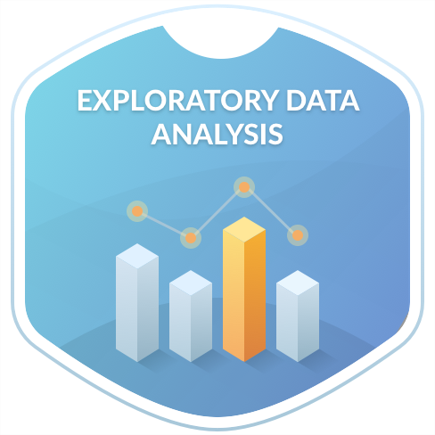
4. Exploratory Data Analysis

Slide 35
4. Exploratory Data Analysis
In statistics, exploratory data analysis (EDA) is an approach to analyzing data sets to summarize their main characteristics, often with visual methods.
A statistical model can be used or not, but primarily EDA is for seeing what the data can tell us beyond the formal modeling or hypothesis testing task.
Exploratory data analysis was promoted by John Tukey to encourage statisticians to explore the data, and possibly formulate hypotheses that could lead to new data collection and experiments.
Lets try to do the EDA with the set of attributes present in the loan dataset that we have prepared.
We can try following type of analysis
Univariate Analysis - explore individual attribute
Bivariate Analysis - explore relationship between two attributes

Slide 36
4. Exploratory Data Analysis
Exploratory Data Analysis (EDA) in statistics - is an approach to
- Analyzing data sets
- Summarize their main characteristics,
- With or without visual methods.
- May or may not require statistical model
- Mainly for getting insight into the data
- Get to know your data Prior to formal modeling or hypothesis testing task.
EDA can be used to formulate hypotheses that could lead to new data collection and experiments.
Lets Explore the loan dataset that we have prepared. We can try following type of analysis
Univariate Analysis - explore individual attribute
Bivariate Analysis - explore relationship between two attributes

Slide 37
4. Exploratory Data Analysis
There are four primary types of EDA:
Univariate non-graphical. This is simplest form of data analysis, where the data being analyzed consists of just one variable.
Since it’s a single variable, it doesn’t deal with causes or relationships.
The main purpose of univariate analysis is to describe the data and find patterns that exist within it.
Univariate graphical. Non-graphical methods don’t provide a full picture of the data. Graphical methods are therefore required.
Common types of univariate graphics include:
  Stem-and-leaf plots, which show all data values and the shape of the distribution.
  Histograms, a bar plot in which each bar represents the frequency (count) or proportion (count/total count) of cases for a range of values.
  Box plots, which graphically depict the five-number summary of minimum, first quartile, median, third quartile, and maximum.

Slide 38
4. Exploratory Data Analysis
Multivariate nongraphical: Multivariate data arises from more than one variable.
Multivariate non-graphical EDA techniques generally show the relationship between two or more variables of the data through cross-tabulation or statistics.
Multivariate graphical: Multivariate data uses graphics to display relationships between two or more sets of data.
The most used graphic is a grouped bar plot or bar chart with each group representing one level of one of the variables and each bar within a group representing the levels of the other variable.

Slide 39
4. Exploratory Data Analysis
Other common types of multivariate graphics include:
Scatter plot, which is used to plot data points on a horizontal and a vertical axis to show how much one variable is affected by another.
Multivariate chart, which is a graphical representation of the relationships between factors and a response.
Run chart, which is a line graph of data plotted over time.
Bubble chart, which is a data visualization that displays multiple circles (bubbles) in a two-dimensional plot.
Heat map, which is a graphical representation of data where values are depicted by color.
Let’s explore the data with Python

Slide 40
4.1 Univariate Analysis
# Set the color coding for the visualizations to be plotted
from matplotlib import cm #This module provides a large set of colormaps, functions for registering new colormaps and for getting a colormap by name, and a mixin class for adding color mapping functionality. This is a mixin class to support scalar data to RGBA mapping.
cmap = cm.get_cmap('jet’) #In matplotlib, various colormaps are defined and can be accessed using a unique name. These names can be accessed using the get_cmap() function in the colormaps module in matplotlib.
cmap1 = cm.get_cmap('Spectral’)
Note: For more about colormaps visit - https://matplotlib.org/stable/users/explain/colors/colormaps.html
https://www.mathworks.com/help/matlab/ref/jet.html

Slide 41
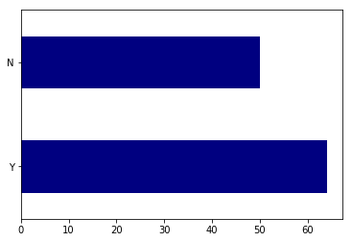
4.1.1 Explore Target Variable
Count of each target variable category will give some insights about the samples those are available for the prediction.
loan_data['Approved'].value_counts() #The value_counts() function returns an object containing counts of unique values. This means it enables us to count the number of unique elements in a column of a Pandas dataframe.
Y 64
N 50
Almost 56% of loans are approved! (= 64 / 64 + 50). Lets visualize it.
loan_data['Approved'].value_counts().plot.barh(cmap=cmap) #Make a horizontal bar plot.

Slide 42
4.1.2 Explore Categorical (Nominal) Independent Variable
Lets try to understand more about the categorical nominal variables like 'Gender', 'Married', "Self_Employed' and 'Credit_History’.
#Prepare a 2 by 2 layout to render these categorical attributes
plt.figure(1) #The figure() function in pyplot module of matplotlib library is used to create a new figure.
plt.subplot(221) #With the subplot() function you can draw multiple plots in one figure:
loan_data['Gender'].value_counts(normalize=True).plot.barh(figsize=(20,10), cmap=cmap, title= 'Gender')
plt.subplot(222)
loan_data['Married'].value_counts(normalize=True).plot.barh(title= 'Married', cmap=cmap1)
plt.subplot(223)
loan_data['Self_Employed'].value_counts(normalize=True).plot.barh(title= 'Self_Employed', cmap=cmap1)
plt.subplot(224)
loan_data['Credit_History'].value_counts(normalize=True).plot.barh(title= 'Credit_History', cmap=cmap)
plt.show()

Slide 43
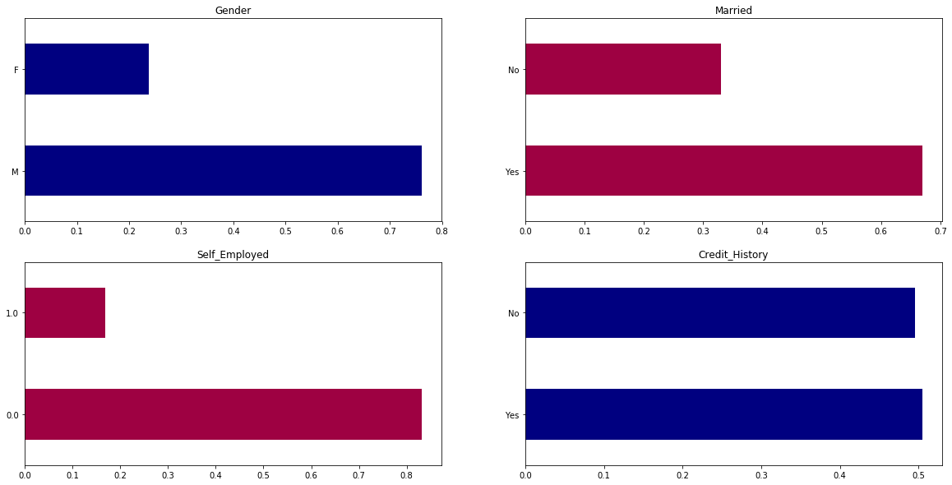
4.1.2 Explore Categorical (Nominal) Independent Variable

Slide 44
4.1.2 Explore Categorical (Nominal) Independent Variable
The inferences are :
75% applicants are male.
67% of the applicants are married.
15% applicants are self employed.
Almost equal number of applicants are there in the regular and defaulter list.
Note: In value_counts(normalize=True). By setting normalize =True ,the object returned will contain the relative frequencies of the unique values.

Slide 45
4.1.2 Explore Categorical (Ordinal) Independent Variable
Lets try to understand more about the categorical ordinal variables like 'Dependents', 'Education', and 'Property_Location’.
#Prepare a layout to render these categorical attributes
plt.figure(1)
plt.subplot(131)
loan_data['Dependents'].value_counts(normalize=True).plot.bar(figsize=(24,6), title= 'Dependents')
plt.subplot(132)
loan_data['Education'].value_counts(normalize=True).plot.bar(title= 'Education', cmap=cmap)
plt.subplot(133)
loan_data['Property_Location'].value_counts(normalize=True).plot.bar(title= 'Property_Location', cmap=cmap1)
plt.show()

Slide 46
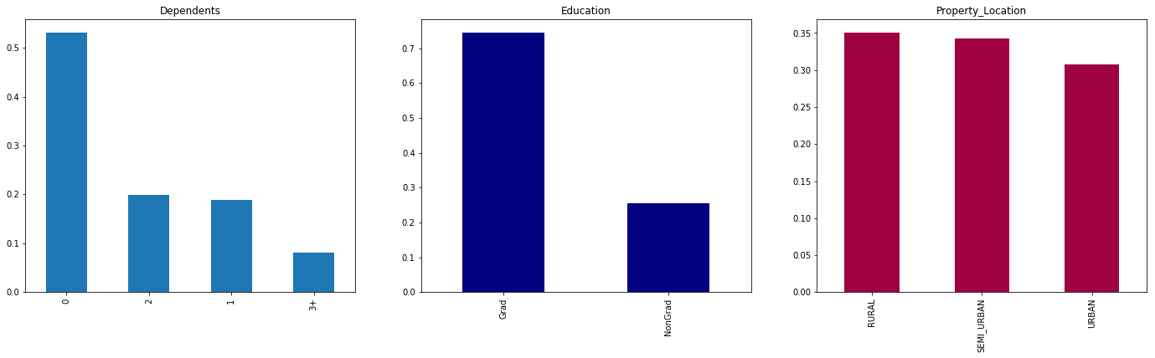
4.1.2 Explore Categorical (Ordinal) Independent Variable

Slide 47
4.1.2 Explore Categorical (Ordinal) Independent Variable
The inferences are :
Applicants with more than three dependents are very less as compared to the ones who are not having any dependents.
More educated applicants are demanding the loans
Almost equal number of samples are drawn from all the localities.

Slide 48
4.1.3 Explore Numerical Independent Variable
Lets try to understand more about the numeric attribute like 'Applicant_Income', 'CoapplicantIncome' and 'Loan_Amt’.
#Prepare a layout to render these numerical attributes
plt.figure(1)
plt.subplot(121)
sns.distplot(loan_data['Applicant_Income'], hist=True, kde=False);
# seaborn.distplot() - The distplot represents the univariate distribution of data i.e. data distribution of a variable against the density distribution.
plt.subplot(122)
loan_data['Applicant_Income'].plot.box(figsize=(16,5)) # Boxplot of the data
plt.show()

Slide 49
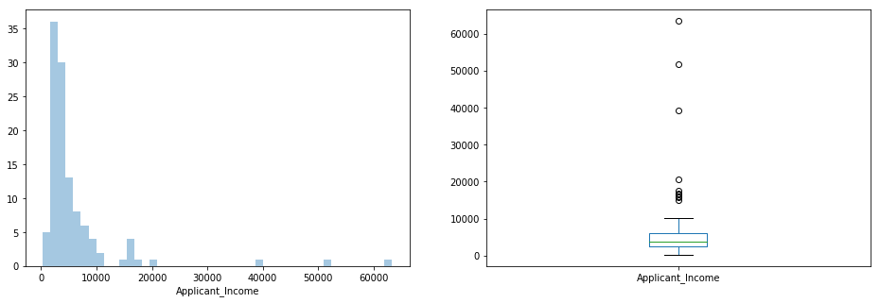
4.1.3 Explore Numerical Independent Variable

Slide 50
4.1.3 Explore Numerical Independent Variable
The inferences are :
Applicant_Income is more tilted towards the left side of the data distribution. Need to normalize it further.
Almost all applicants have income less than 10000 but still few applicants are falling in higher income bracket.

Slide 51
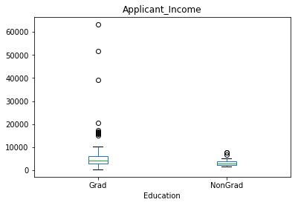
4.1.3 Explore Numerical Independent Variable
Lets see if the education level has some impact on the income or not
loan_data.boxplot(column='Applicant_Income', by = 'Education', grid=False,)
plt.suptitle("")

Slide 52
4.1.3 Explore Numerical Independent Variable
Inference :
Graduates tend to be earning more than 10000 than non graduates..
People in higher income bracket are graduates.

Slide 53
4.1.3 Explore Numerical Independent Variable
Let’s look at the Coapplicant income distribution.
plt.figure(1)
plt.subplot(121)
sns.distplot(loan_data['CoapplicantIncome'], hist=True, kde=True); #kernel density estimate to smooth the distribution
plt.subplot(122)
loan_data['CoapplicantIncome'].plot.box(figsize=(16,5))
plt.show()

Slide 54
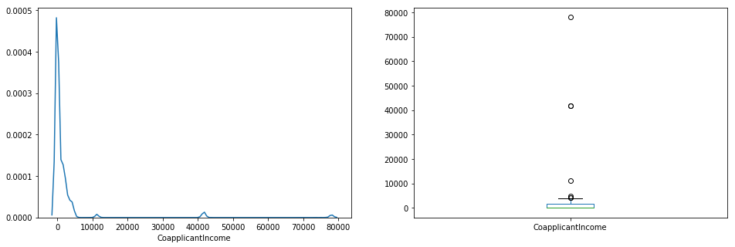
4.1.3 Explore Numerical Independent Variable

Slide 55
4.1.3 Explore Numerical Independent Variable
Inference :
Almost similar distribution is seen as that of applicant income.

Slide 56
4.1.3 Explore Numerical Independent Variable
Let’s look at the distribution of Loan_Amt variable.
plt.figure(1)
plt.subplot(121)
df=loan_data.dropna() # The dropna() method removes the rows that contains NULL values.
sns.distplot(df['Loan_Amt']);
plt.subplot(122)
df['Loan_Amt'].plot.box(figsize=(16,5))
plt.show()

Slide 57
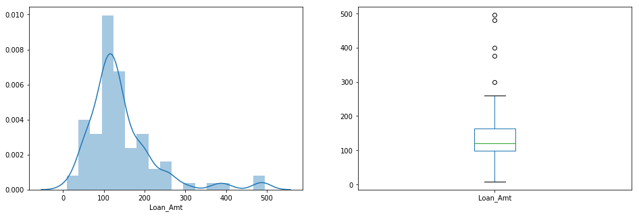
4.1.3 Explore Numerical Independent Variable

Slide 58
4.1.3 Explore Numerical Independent Variable
Inference :
Loan_Amt distribution is normal.
Some outliers are present which need to be handled afterwards.

Slide 59
4.2 Bivariate Analysis
We got fair idea about the distribution of the categorical and numerical attributes present in data frame.
Lets explore the relationship between these variables and the target.

Slide 60
4.2.1 Compare Categorical Variables with Target
#Set the visuzalization style
from matplotlib import cm
cmap = cm.get_cmap('Spectral’)
Lets explore relationship between 'Gender' and approval status.
Gender=pd.crosstab(loan_data['Gender'],loan_data['Approved'])
Gender
Approved | N | Y
Gender
F | 16 | 10
M | 33 | 50

Slide 61
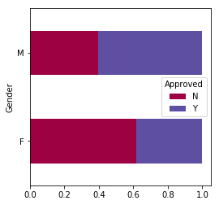
4.2.1 Compare Categorical Variables with Target
Gender.div(Gender.sum(1).astype(float), axis=0).plot(kind="barh", cmap=cmap, stacked=True, figsize=(4,4))
Inference :
More number of male are given loans as compared to females.

Slide 62
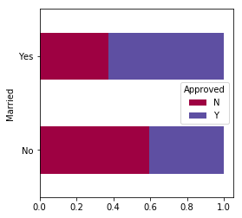
4.2.1 Compare Categorical Variables with Target
Now let us visualize the remaining categorical variables vs target variable.
Married=pd.crosstab(loan_data['Married'],loan_data['Approved'])
Married.div(Married.sum(1).astype(float), axis=0).plot(kind="barh", cmap=cmap, stacked=True, figsize=(4,4))
plt.show()
Inference:
Proportion of married applicants is higher for the approved loans.
Proportion of unmarried applicants is higher for the rejected loans.

Slide 63
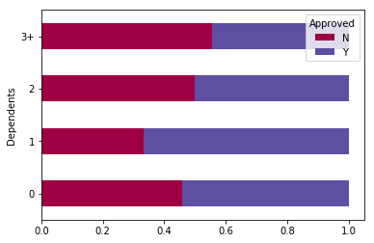
4.2.1 Compare Categorical Variables with Target
Dependents=pd.crosstab(loan_data['Dependents'],loan_data['Approved'])
Dependents.div(Dependents.sum(1).astype(float), axis=0).plot(kind="barh", cmap=cmap, stacked=True)
plt.show().
Inference:
Distribution of applicants with 0, 2 or 3+ dependents is similar across both the categories of Loan_Status.
Applicants with only single dependents are approved more loans.

Slide 64
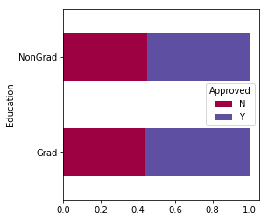
4.2.1 Compare Categorical Variables with Target
Education=pd.crosstab(loan_data['Education'],loan_data['Approved'])
Education.div(Education.sum(1).astype(float), axis=0).plot(kind="barh", cmap=cmap,stacked=True, figsize=(4,4))
plt.show()
Inference:
There is only a small variation in loan approval for graduates vs. non graduates.

Slide 65
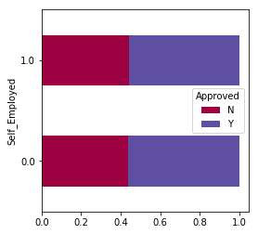
4.2.1 Compare Categorical Variables with Target
Self_Employed=pd.crosstab(loan_data['Self_Employed'],loan_data['Approved'])
Self_Employed.div(Self_Employed.sum(1).astype(float), axis=0).plot(kind="barh", cmap=cmap,stacked=True, figsize=(4,4))
plt.show()
Inference:
There is nothing significant we can infer from Self_Employed vs Approved plot.

Slide 66
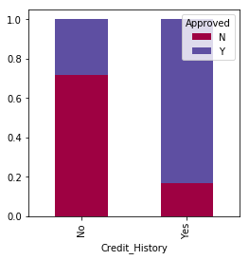
4.2.1 Compare Categorical Variables with Target
Now we will look at the relationship between remaining categorical independent variables and loan approval status.
Credit_History=pd.crosstab(loan_data['Credit_History'],loan_data['Approved'])
Credit_History.div(Credit_History.sum(1).astype(float), axis=0).plot(kind="bar", cmap=cmap, stacked=True, figsize=(4,4))
plt.show()
Inference: It seems people without any previous credit history are not approved of the loans.

Slide 67
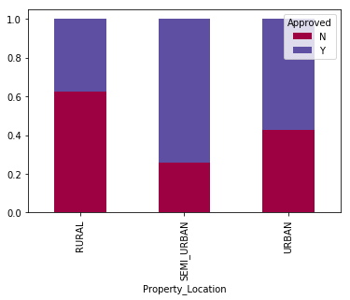
4.2.1 Compare Categorical Variables with Target
Property_Area=pd.crosstab(loan_data['Property_Location'],loan_data['Approved'])
Property_Area.div(Property_Area.sum(1).astype(float), axis=0).plot(kind="bar", cmap=cmap, stacked=True)
plt.show()
Inference: It seems applicants from semi-urban area get loans easily.

Slide 68
4.2 Bivariate Analysis – cont.
As discussed in the beginning, lets see the variables that we considered as important from the loan approval perspective are really playing the significant role or not.
Salary: Applicants with high income should easily get loans.
Credit history: Applicants who have repaid their previous debts should have higher chances of loan approval.
Loan amount: If the loan amount is less, chances of loan approval should be high.
Loan tenure: Loan for less time period and less amount should have higher chances of approval.
EMI: Lesser the amount to be paid monthly to repay the loan, higher the chances of loan approval.

Slide 69
4.2.2 Correlation Analysis
Now lets look at the correlation between all the numerical variables. We will use the heat map to visualize the correlation. Heatmaps visualize data through variations in coloring. The variables with darker color means their correlation is more.
matrix = loan_data.corr() # pairwise correlation of all columns in the Pandas Dataframe in Python. Any NaN values are automatically excluded.
f, ax = plt.subplots(figsize=(9, 6)) #plt.subplots() is a function that returns a tuple containing a figure and axes object(s).
sns.heatmap(matrix, vmax=.8, square=True, cmap="OrRd");

Slide 70
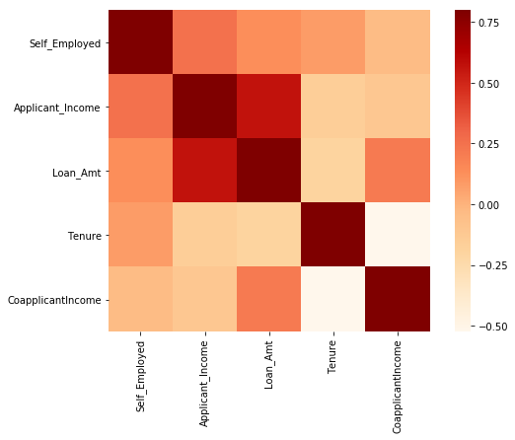
4.2.2 Correlation Analysis

Slide 71
4.2.2 Correlation Analysis
Inference:
Loan amount and income seems to be highly related.
Loan amount and coapplicant income seems to be highly related.
Income and employment status (self employed or salaried) are related.

Slide 72
4. Data pre-processing – Data cleaning, Label encoding, Discretization and Normalization
5. Feature Engineering
6. Model Building
7. Model Selection
Will be continued by Dr. Murtuza Dahodwala

Slide 73
References
https://matplotlib.org/stable/users/index.html
https://seaborn.pydata.org/tutorial.html
https://www.w3schools.com/python/pandas/default.asp
https://numpy.org/doc/stable/user/quickstart.html
https://docs.python.org/3/library/warnings.html#:~:text=Warning%20messages%20are%20typically%20issued,program%20uses%20an%20obsolete%20module.
https://realpython.com/pandas-read-write-files/#:~:text=Read%20Files,-pandas%20functions%20for&text=You've%20already%20seen%20the,read_html()
https://seaborn.pydata.org/generated/seaborn.heatmap.html

Slide 74


Slide 75


